Slide 1
Why can you kill mosquitoes in the dark?
Towards solving sound localization with a biologically plausible spiking neural simulation
11.12.2024 | Paolo Marzolo
Advisor:
Co-Advisor:
Prof. Alberto Antonietti
Francesco De Santis
Notes:
This presentation will follow a standard format, so let’s get started with the theory background

Slide 2
Contents
01
02
03
04
05
Introduction and
Background
Objectives
Methods
Results
Discussion
Auditory Cues
Biological sound processing:
Peripheral
Neural
Input range and bioplausibility
Myoga's MSO
IC evaluation by sigmoid fit pre vs post MSO
Peripheral processing
Neural processing
Auditory Nerve Fibers output
Higher centers
MSO impact on IC
Peripheral processing properties
Neural bioplausibility
IC impact and literature

Slide 3
Background
01

Slide 4
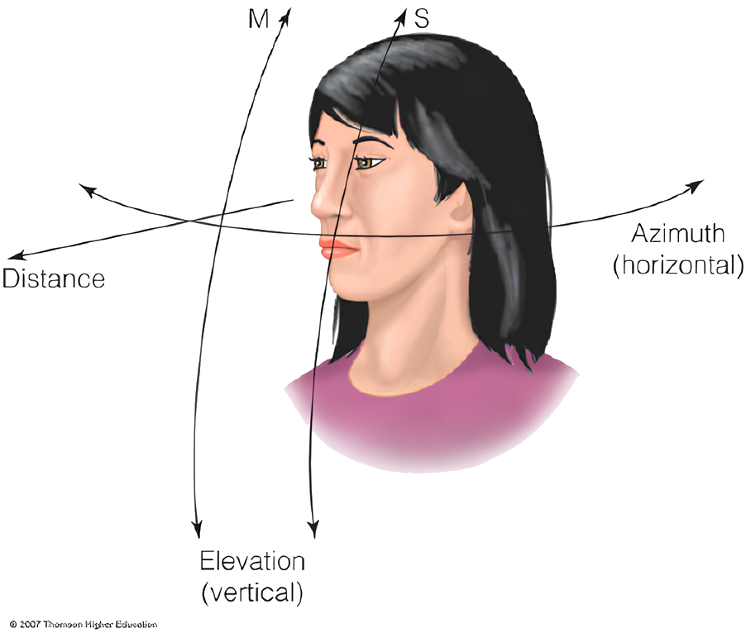
Sound localization basics
Determining the source location of a sound
Must be derived
Derivation based on three main features (auditory cues)
Thompson Higher Education
Notes:
the task of

Slide 5
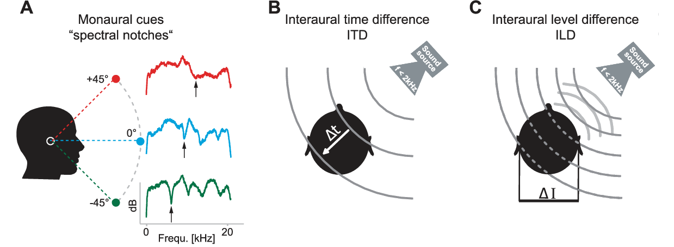
Auditory Cues
Grothe, B., Pecka, M., McAlpine, D., 2010. Mechanisms of Sound Localization in Mammals. Physiological Reviews 90, 983–1012
Notes:
Because our work focuses on azimuthal localization, we will focus on the first two.
The representation of how all attenuations, amplifications and reflections affect the two sounds differently is called the HRTF, or in time domain HRIR.

Slide 6
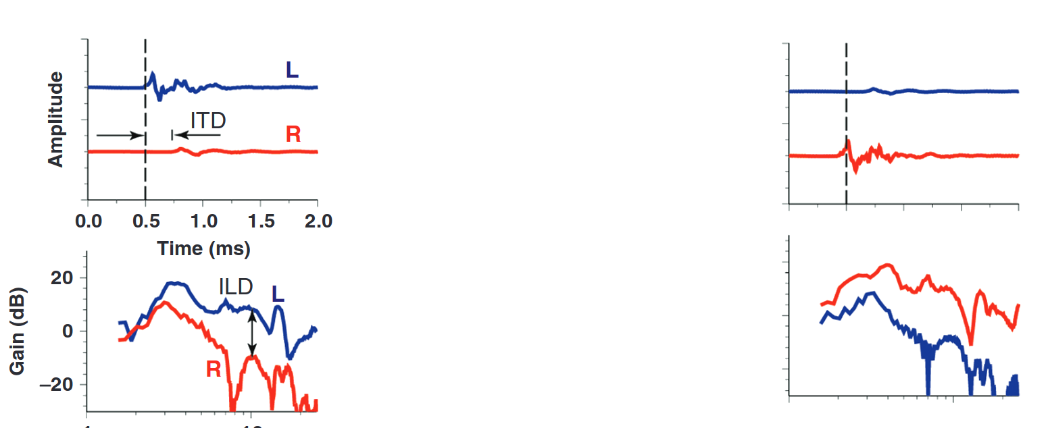
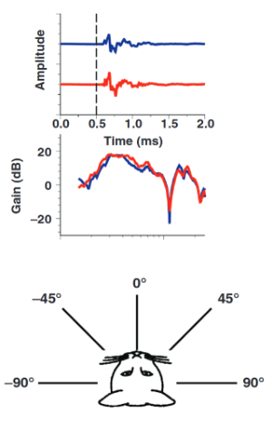

HRTF: Head-Related Transfer Function
Notes:
Each point in space has a corresponding HRTF. For example, at -90, so full left, ...

Slide 7
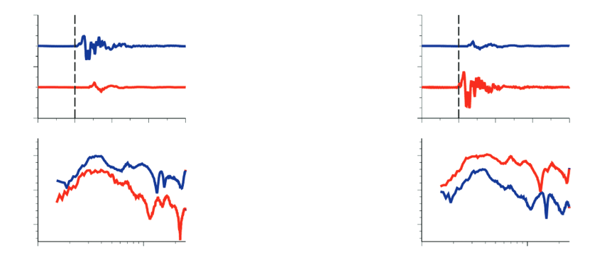
Yin, T.C.T., Smith, P.H., Joris, P.X., 2019. Neural Mechanisms of Binaural Processing in the Auditory Brainstem,
Comprehensive Physiology. Wiley, pp. 1503–1575

Slide 8
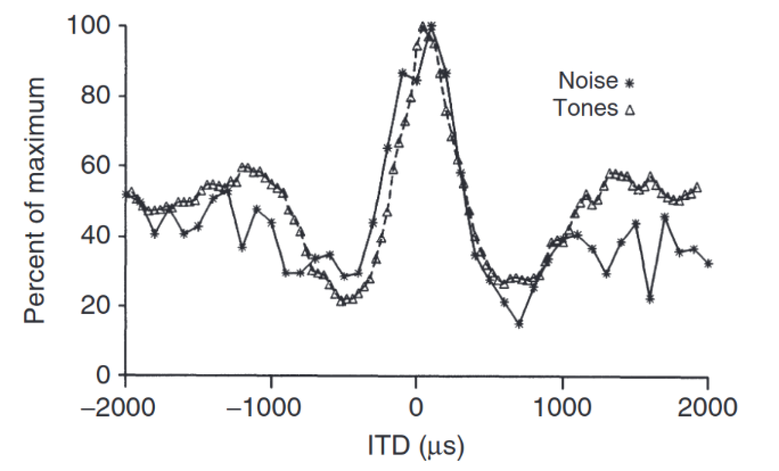
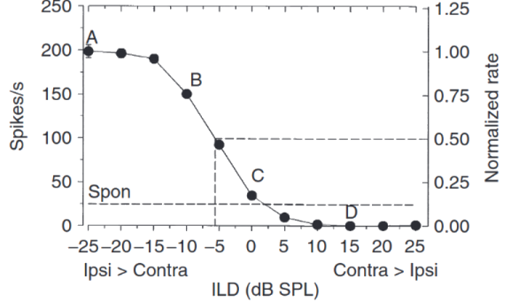
Associated Nuclei
Lateral Superior Olive (LSO) -> ILD
Medial Superior Olive (MSO) -> ITD
Yin, T.C.T., Smith, P.H., Joris, P.X., 2019. Neural Mechanisms of Binaural Processing in the Auditory Brainstem,
Comprehensive Physiology. Wiley, pp. 1503–1575
Notes:
These cues are especially important because they are the main driver for the response behavior of the two nuclei where binaural information first converge, the LSO and MSO

Slide 9
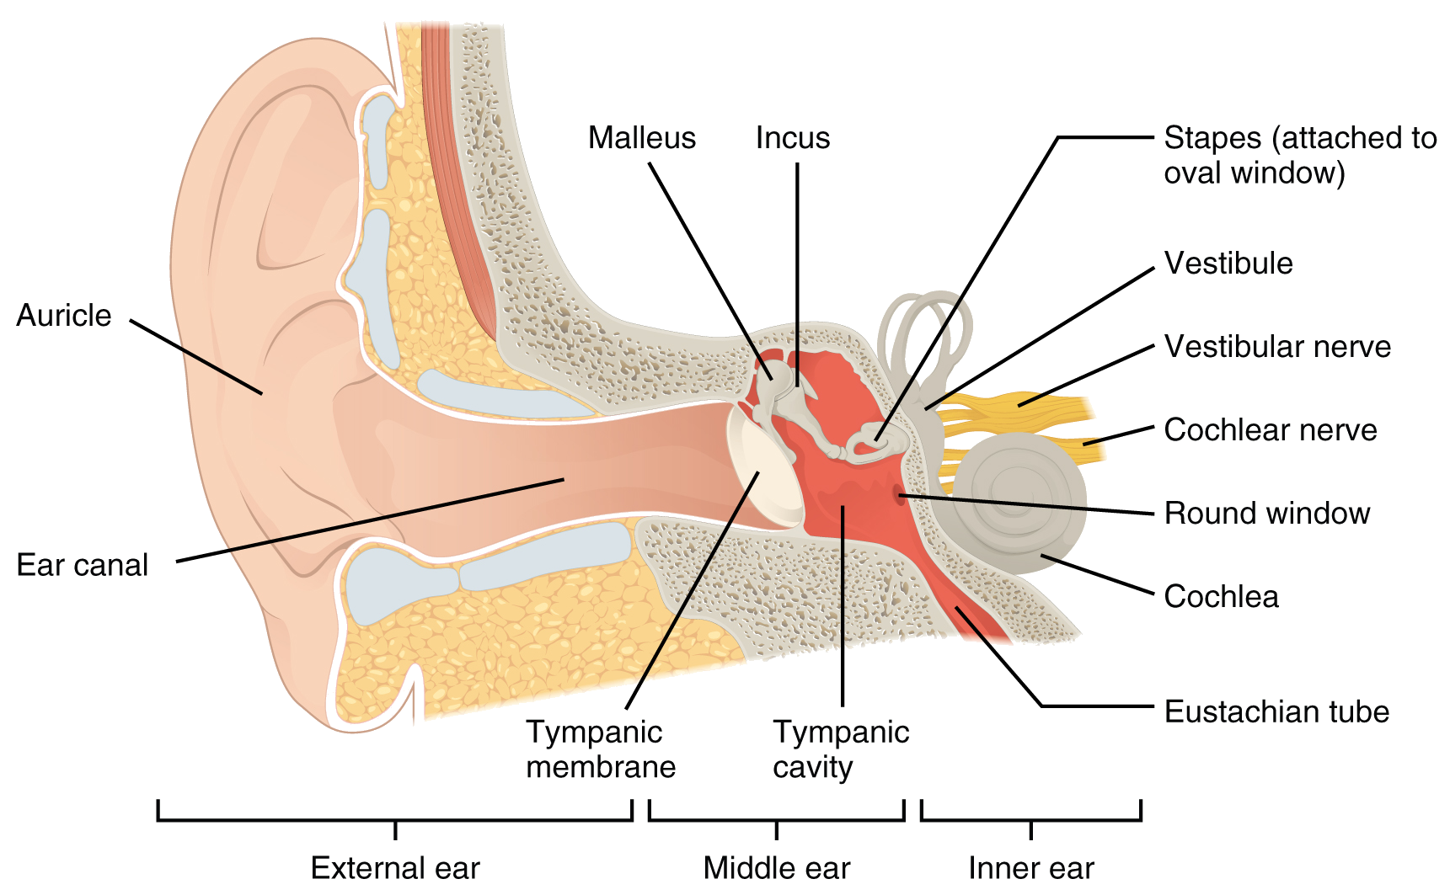
Peripheral Processing
Pinna/auricle
Middle ear
Cochlea
Inner Hair Cell
Auditory Nerve Synapse
L. M. Biga et al., Anatomy & Physiology. OpenStax/Oregon State University, 2019. Accessed: Nov. 27, 2024. [Online]. Available: https://open.oregonstate.education/aandp/
Notes:
These are the main steps of the process, from which two main properties (for localization task)

Slide 10
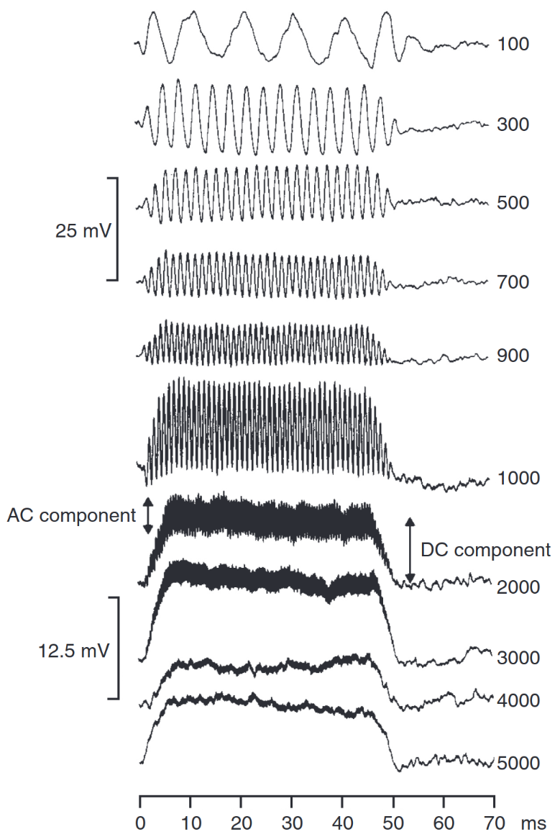
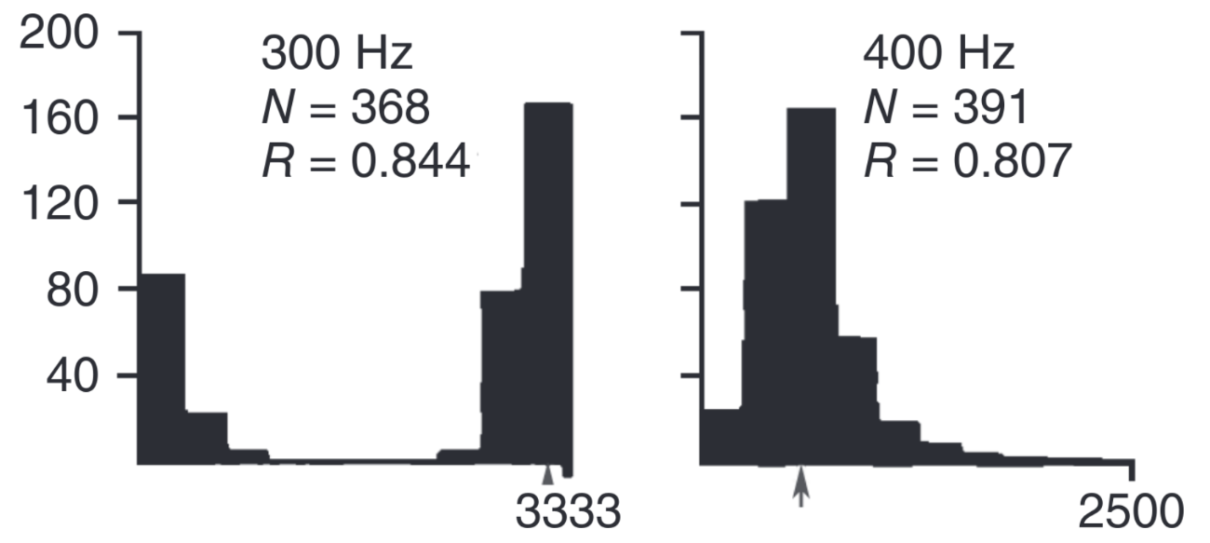
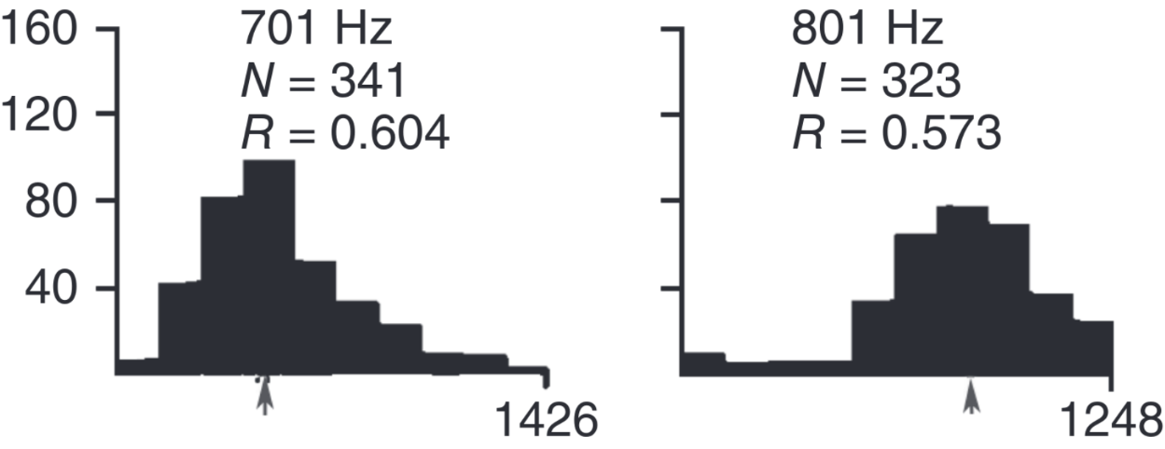
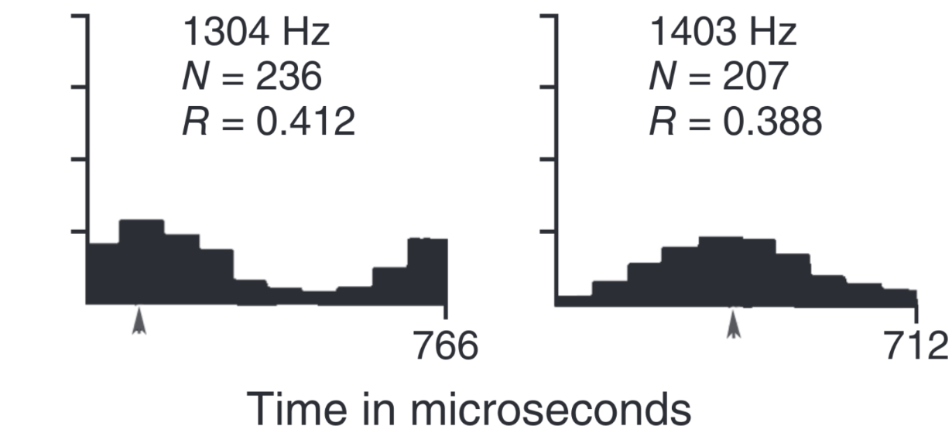
Property 1: Phase Locking
IHC graded potential
ANF spikes
VS
The ability of fibers to synchronize firing rate with a specific phase of the input wave
Falls off around 2 kHz
Possible metric to evaluate is Vector Strength
VS
VS
Yin, T.C.T., Smith, P.H., Joris, P.X., 2019. Neural Mechanisms of Binaural Processing in the Auditory Brainstem
Notes:
Property 1: phase locking at low freq
Vector Strength: each spike is a a vector (of angle=phase), take the average vector length

Slide 11
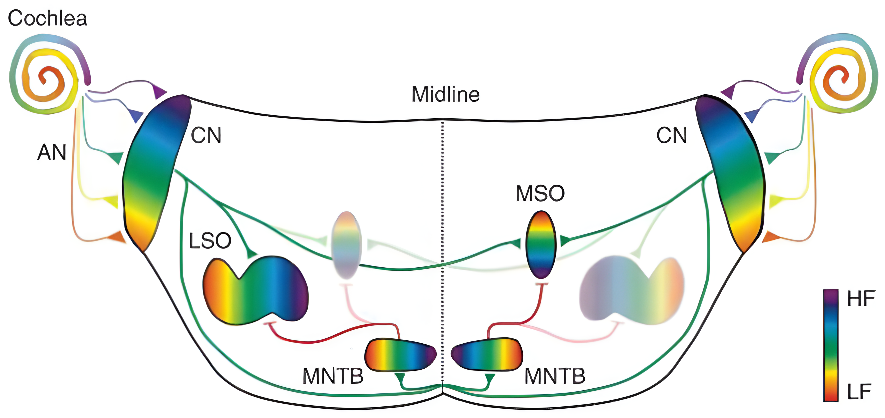
Property 2: Tonotopic Organization
HIGH FREQUENCY
LOW FREQUENCY
Kandler, K., Clause, A., Noh, J., 2009. Tonotopic reorganization of developing auditory brainstem circuits. Nat Neurosci 12, 711–717
Notes:
Property 2: tonotopic organization

Slide 12
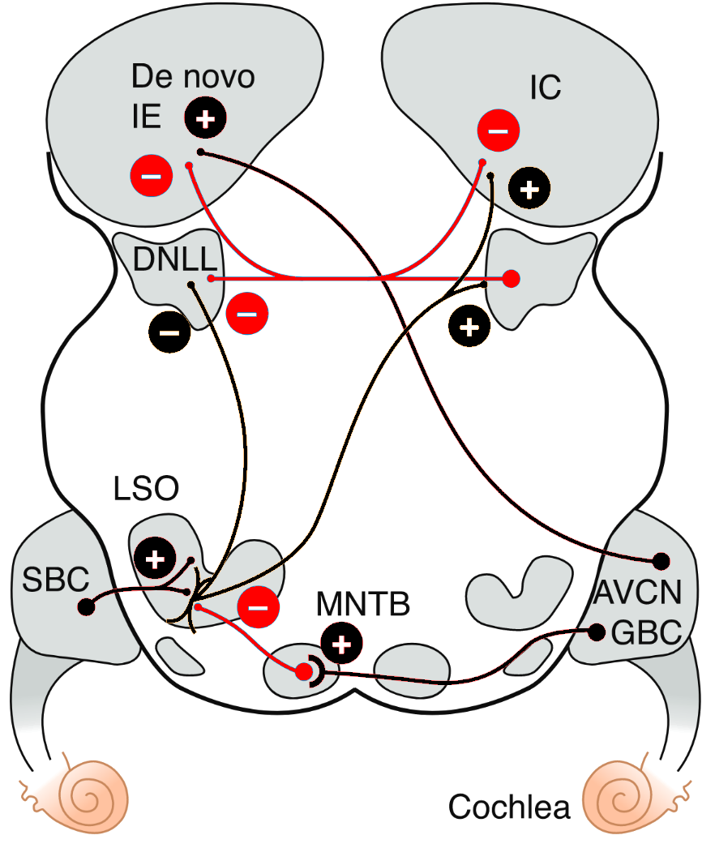
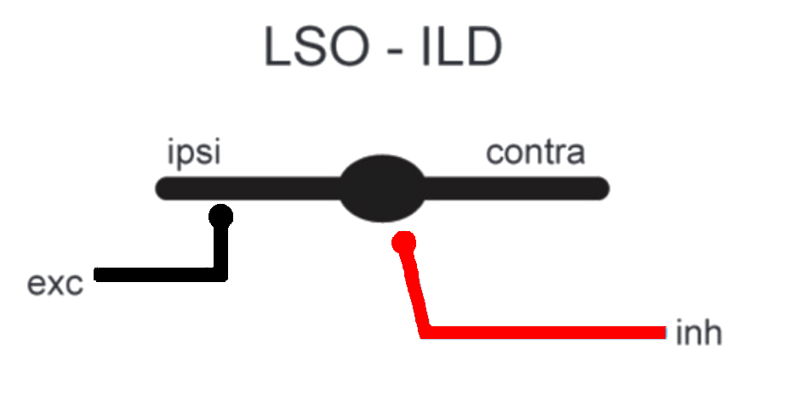
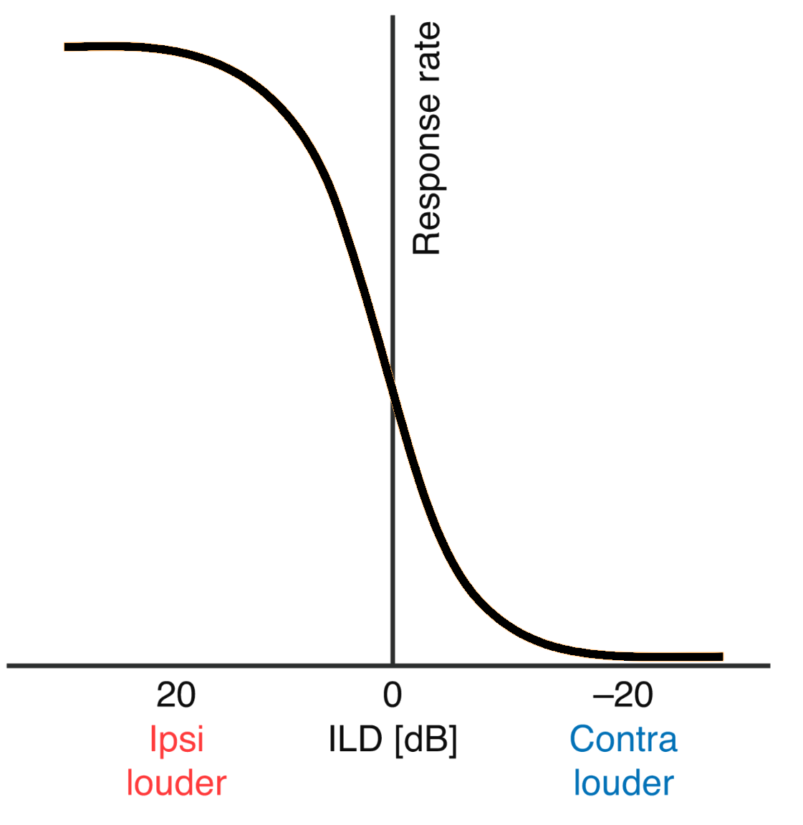
Complete network (LSO)
Auditory Nerve Fibers (ANFs) first neural component
Bushy cells refine phase-locking
Medial Nucleus of the Trapezoid Body provides inhibition
Notice convergence
ANF
ANF
Grothe, B., Pecka, M., McAlpine, D., 2010. Mechanisms of Sound Localization in Mammals. Physiological Reviews 90, 983–1012
Notes:
Start with the LSO

Slide 13
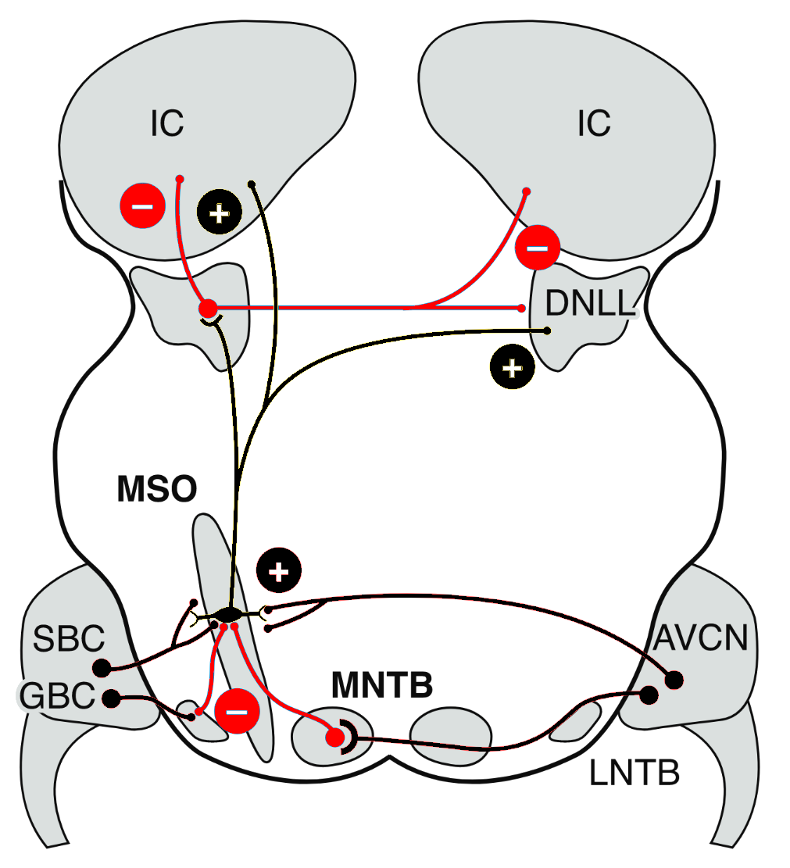
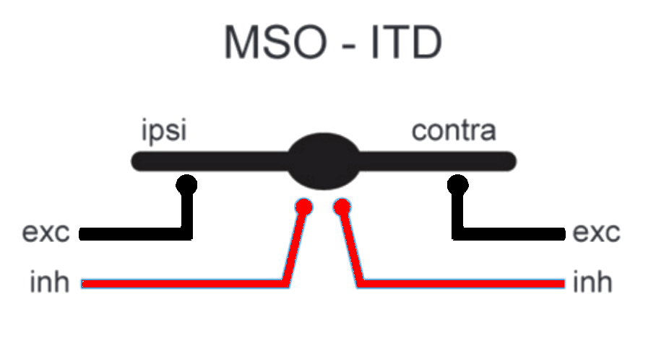
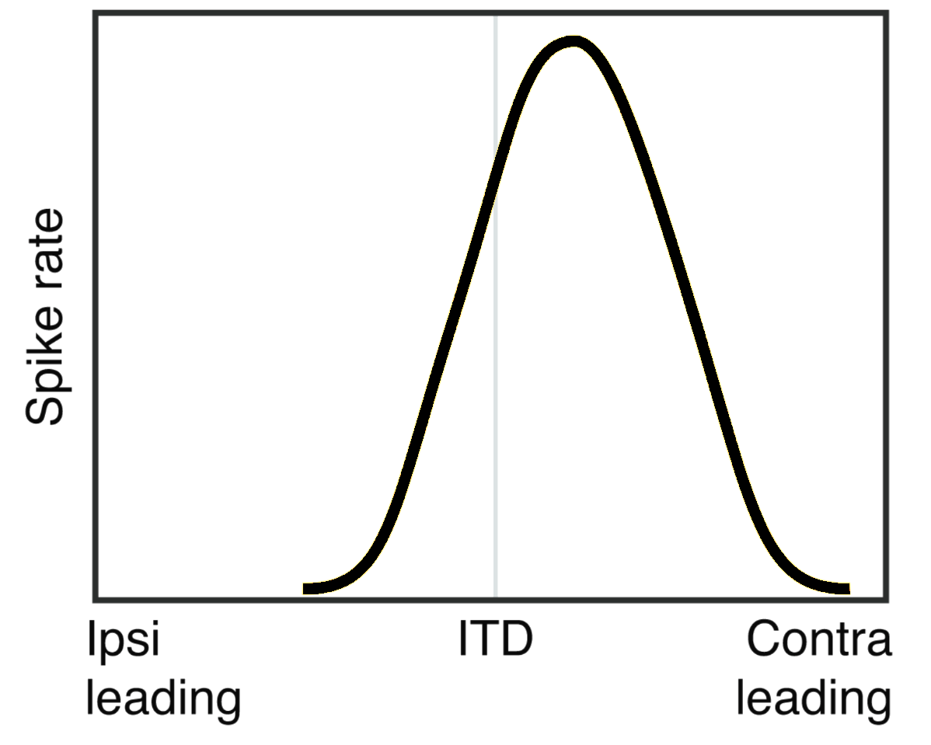
Complete network (MSO)
Auditory Nerve Fibers (ANFs) first neural component
Bushy cells refine phase-locking
Medial and Lateral Nuclei of the Trapezoid Body provide inhibition
Notice convergence
ANF
LNTB
ANF
Grothe, B., Pecka, M., McAlpine, D., 2010. Mechanisms of Sound Localization in Mammals. Physiological Reviews 90, 983–1012

Slide 14
Left/right integration mechanism
ILD coding in LSO
ITD coding in MSO
Known
Based on Inhibitory-Excitatory scheme
Multiple possible strategies
More complex scheme:
Two inh sources
Two exc sources
Notes:
LSO noto, MSO no

Slide 15
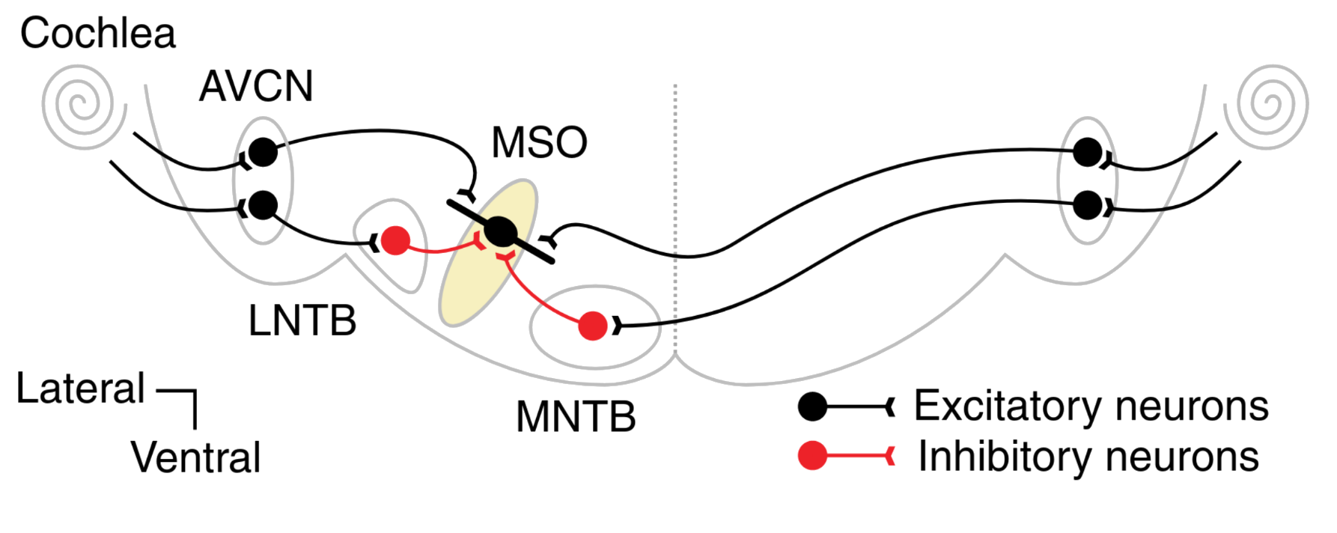
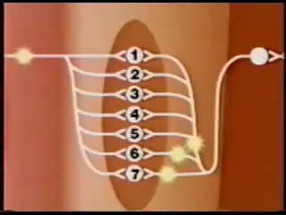
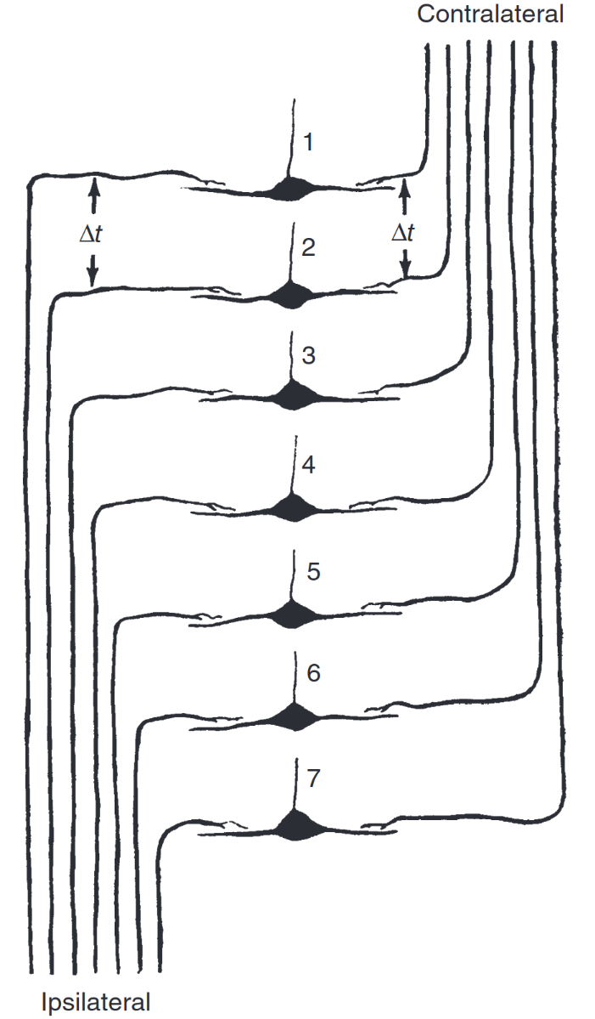

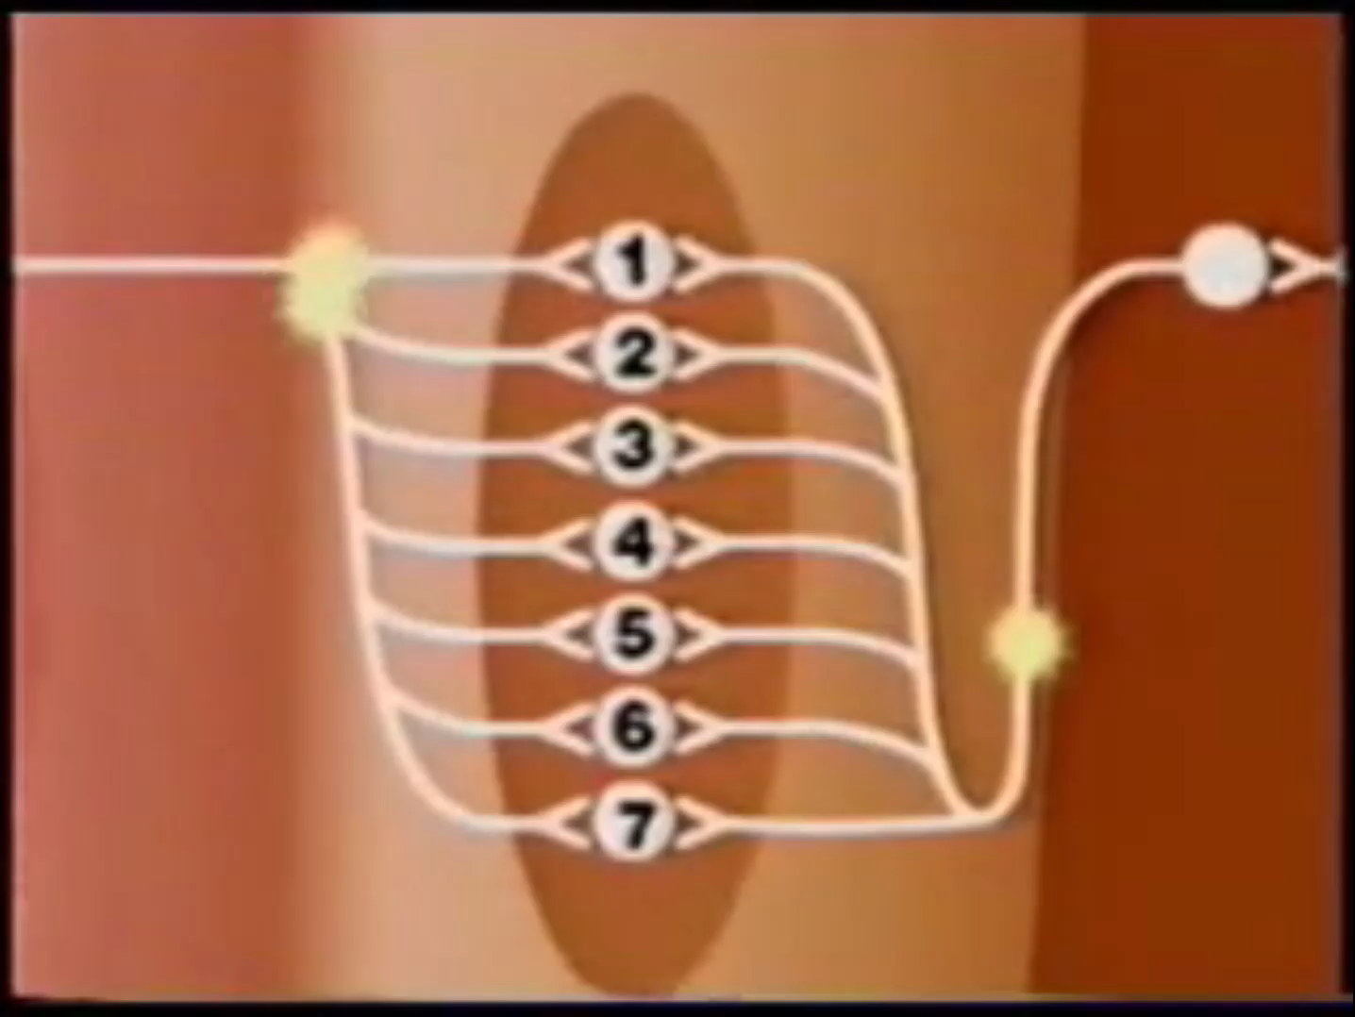
ITD coding strategies
Jeffress-based
ISSUES
No evidence of delay lines in mammals
ITD differ at different frequencies (suggests IPD)
No role for inhibition (MNTB!)
COINCIDENCE DETECTORS
The Jeffress Model - Animation | Auditory Neuroscience. URL https://auditoryneuroscience.com/spatial-hearing/jeffress-model-animation
Notes:
MSO Jeffress e problemi

Slide 16
Objectives
02

Slide 17
Objectives
Implement peripheral processing sections at different bioplausibility levels
Evaluate effect of these peripheral sections on higher nuclei
Improve bioplausibility of the model
Notes:
Mention existing model

Slide 18
Objectives
Implement peripheral processing sections at different bioplausibility levels
Evaluate effect of these peripheral sections on higher nuclei
Improve bioplausibility of the model
Use alternative strategy for ITD coding in the MSO
Used fixed difference in arrival times of each inh to the exc from same side to obtain shift of ITD with maximal response
Myoga et al., 2014. Glycinergic inhibition tunes coincidence detection in the auditory brainstem. https://doi.org/10.1038/ncomms4790
Notes:
Mention existing model

Slide 19
Objectives
Improve bioplausibility of the model
Implement peripheral processing sections at different bioplausibility levels:
Pulse-packet generators
Gammatone-based
Tan Carney-based
Evaluate effect of these peripheral sections on higher nuclei
Notes:
Mention existing model

Slide 20
Objectives
Improve bioplausibility of the model
Use Myoga’s principles for ITD coding in the MSO
Used fixed difference in arrival times of each inh to the exc from same side to obtain shift of ITD with maximal response
Notes:
Mention existing model

Slide 21
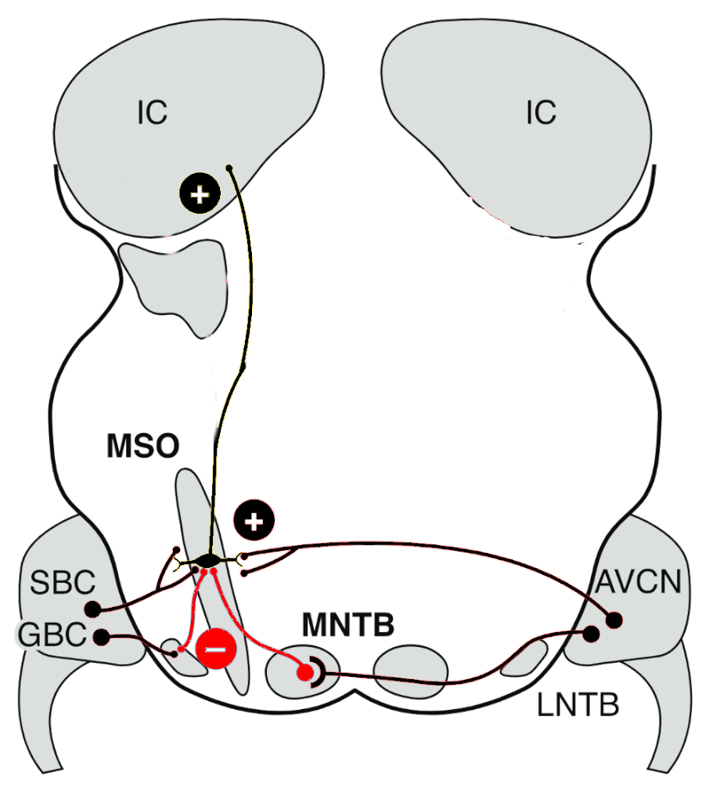
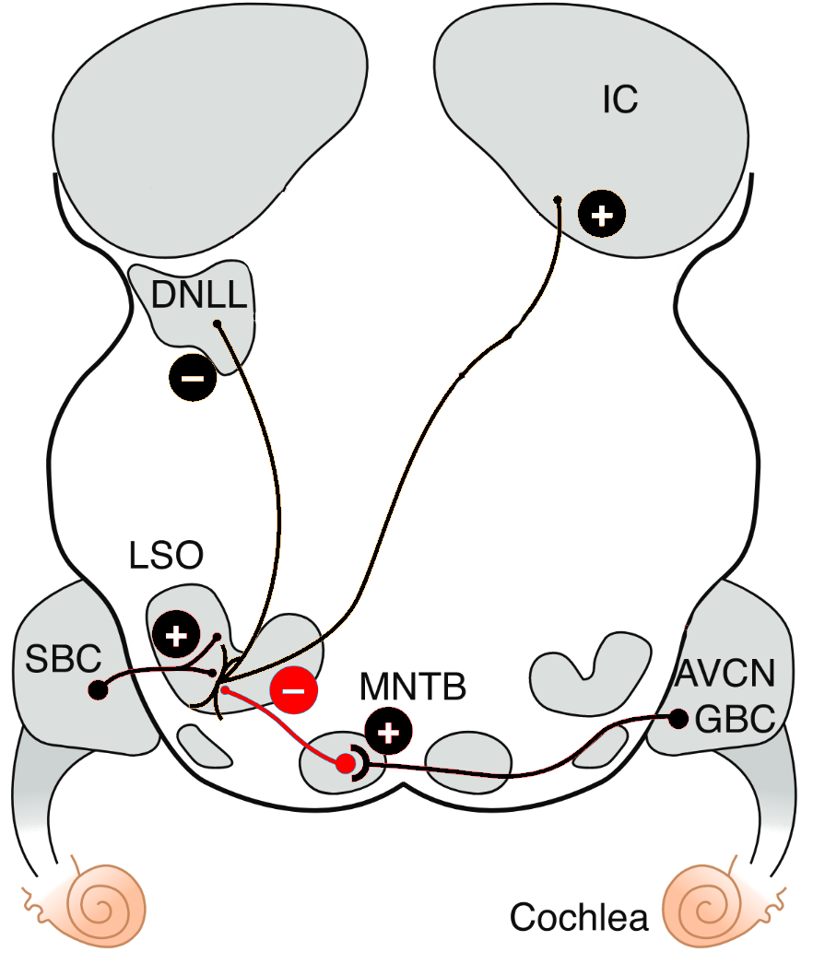
Objectives
Inferior Colliculus (IC)
Improve bioplausibility of the model
Use Myoga’s principles for ITD coding in the MSO
Consider a simple scheme for cue integration above LSO and MSO
IC
IC
Excitatory
Excitatory
MSO (ipsi)
LSO (contra)
Notes:
The connectivity above the nuclei we mentioned becomes complex, but one clear pathway is excitatory…

Slide 22
Methods
03

Slide 23
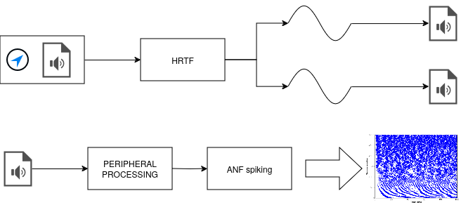
Peripheral Processing
Identified common scheme for all peripheral processing
HRTF creates two sounds
Exact following steps depend on the peripheral processing
Notes:
let's start with peripheral processing

Slide 24
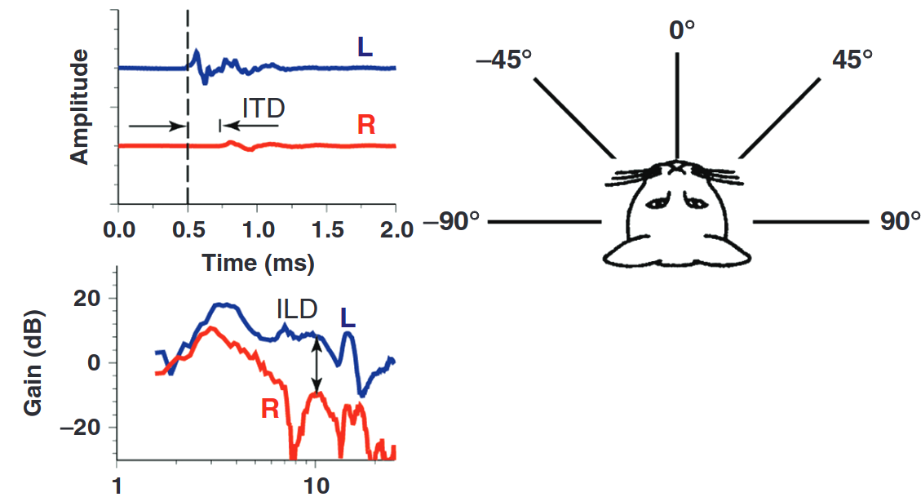
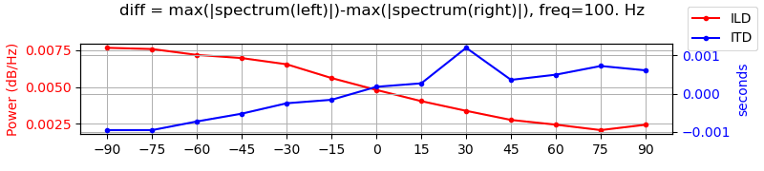

Peripheral Processing: HRTFs
Evaluate HRTF impact on auditory cues
Notes:
In order to evaluate HRTF impact on auditory cues, we manually calculated ITD and ILD after applying the HRTF to each input type

Slide 25
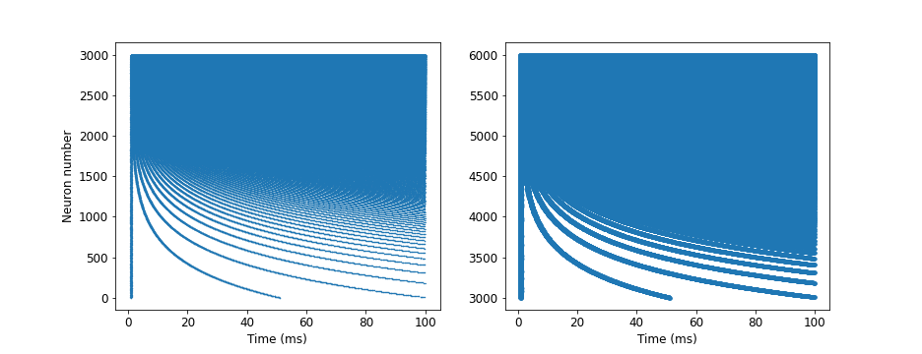
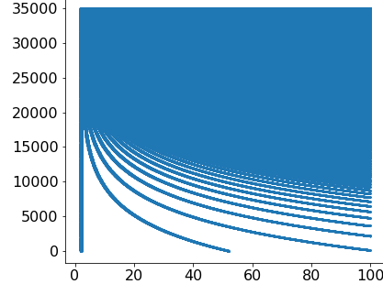
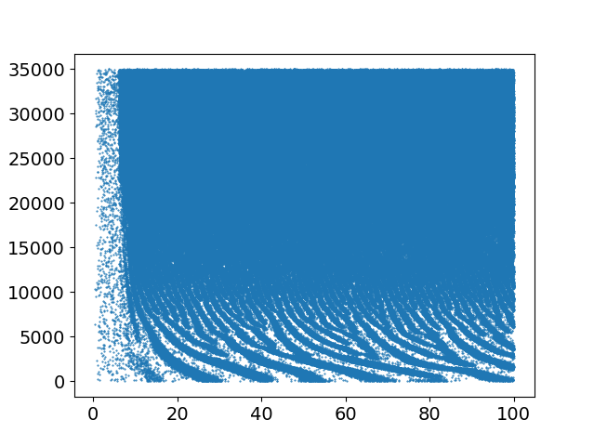
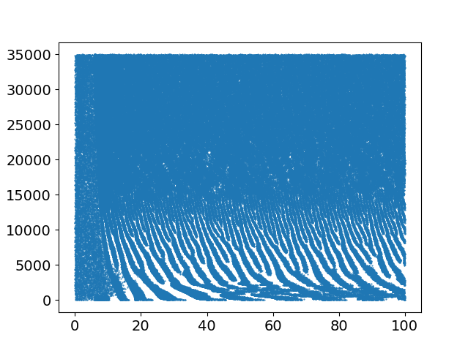
Peripheral Processing: Inner Ear
Three peripheral processing sections at three bio-plausibility levels
Compared using vector strength
Pulse Packet Generators
Gammatone-based
Tan-Carney-based
Holdsworth, J., Patterson, R., Nimmo-Smith, I., 1988. Implementing a GammaTone Filter Bank.
Tan, Carney, 2003. A phenomenological model for the responses of auditory-nerve fibers. II. Nonlinear tuning with a frequency glide
Notes:
Instead, for the peripheral processing, we implemented three peripheral processing sections and compared them using vector strength. As a preliminary result, we can see in scatter plot….
Pulse packet -> tonotopical
Gammatone -> realistic frequency selectivity
Tan-carney -> spontaneous activity

Slide 26
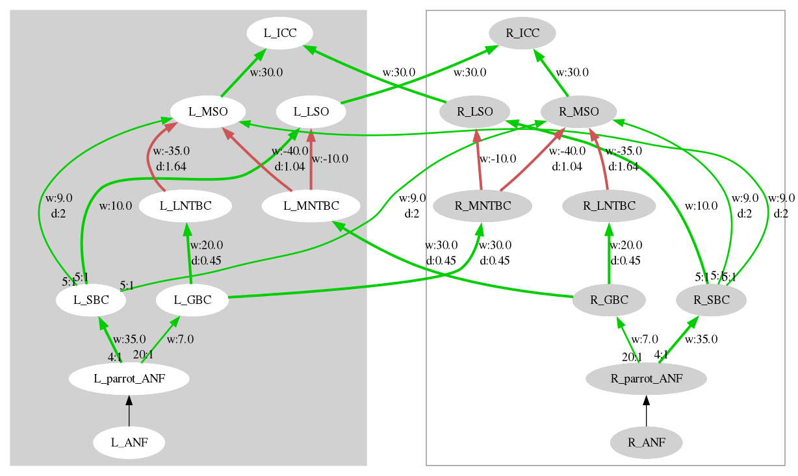

Network Structure
Notes:
Evidenzi una pop: come possiamo valutare la response di una pop neurale? Prox slide

Slide 27

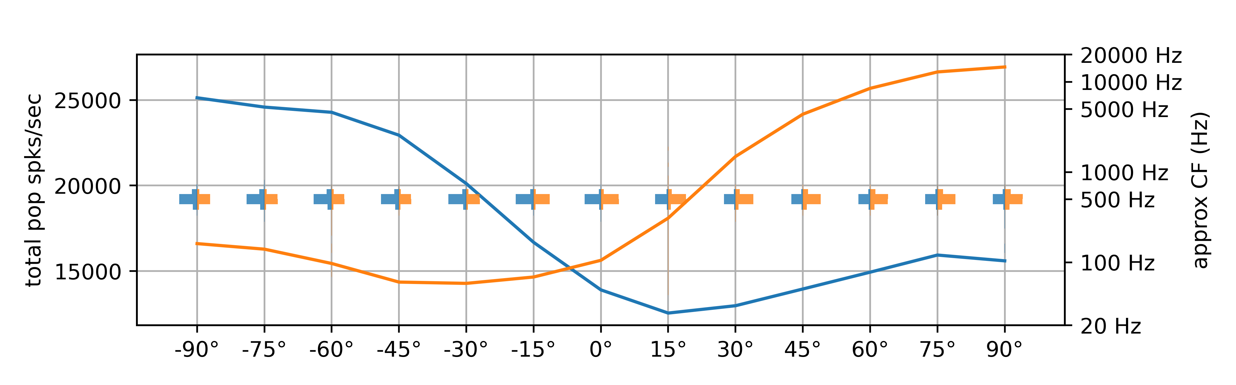
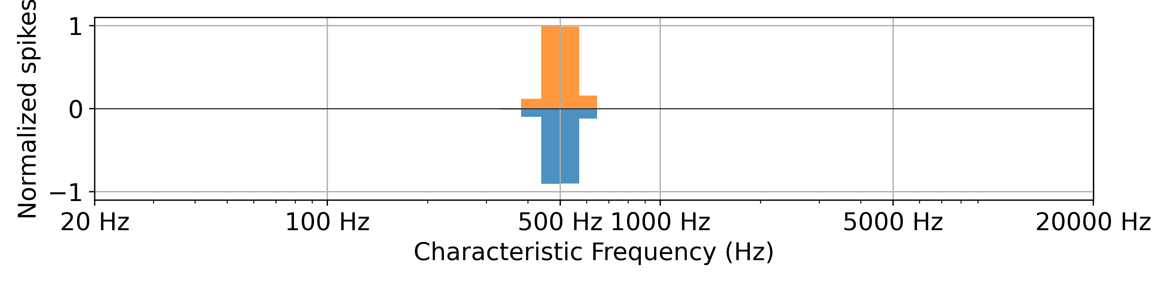
Neural Processing
LEFT
RIGHT
Bushy cells, gammatone, 500Hz
Total population activation
Tonotopic fiber activation (where?)
Bushy cells, 0°, Tonotopic activation
Notes:
To evaluate population activation, we used the total number of spikes per second. Our result plots are focused on showing how activation varies for different angles and which section of the population contributes to this result

Slide 28
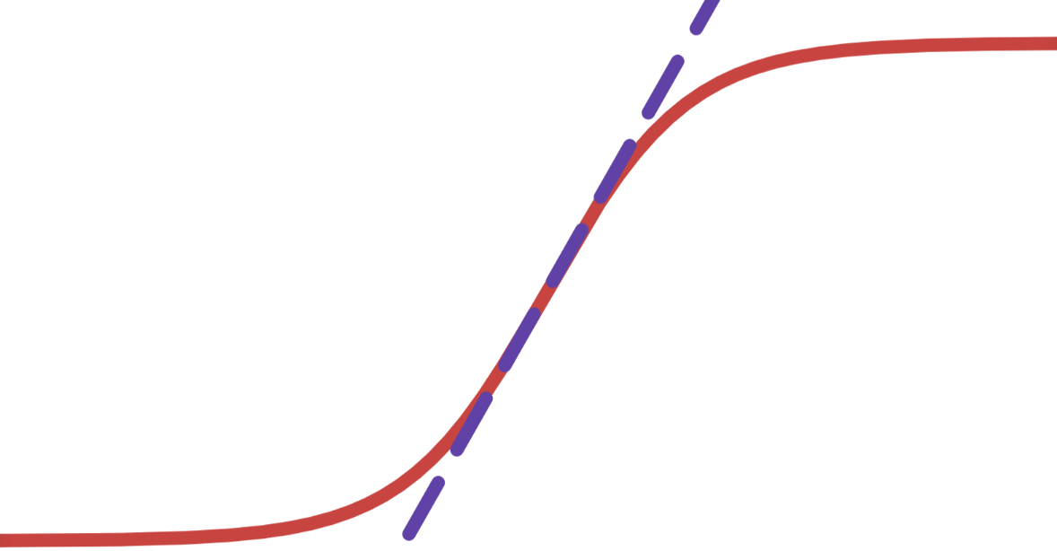
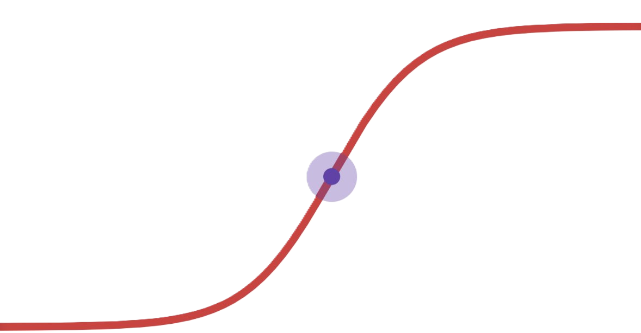
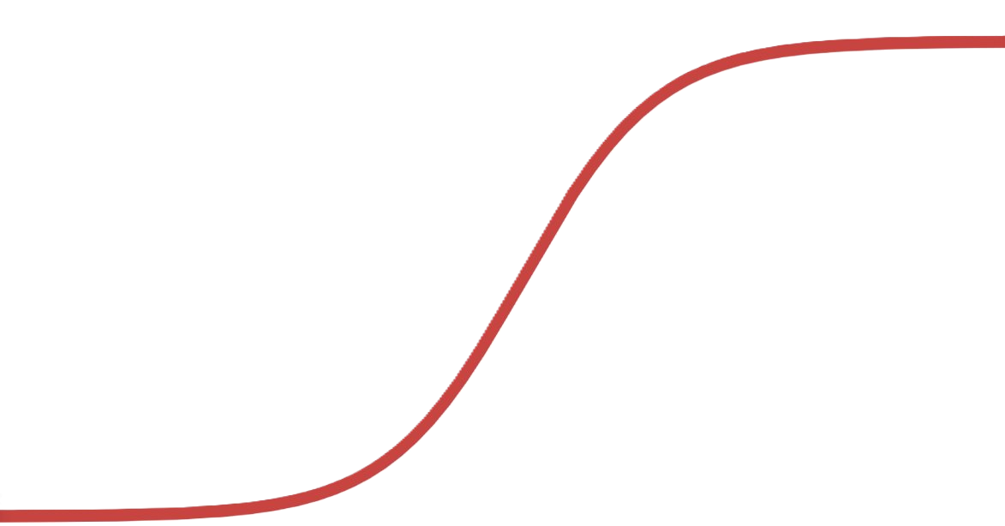
Inferior Colliculus Model
Steepness around zero
Normalized Δ response
Zero-degree accuracy
Fit difference in activation to a sigmoid
Following metrics were evaluated:
Normalized Δ response
Range
Normalized Δ response
Notes:
To evaluate the inferior colliculus model, we fitted the difference in activity between right and left inferior colliculi to a sigmoid, and evaluated
Since behavioral results show no difference between right and left azimuthal localization accuracy, the center point (zero degrees) should show equal activation in both populations;
Just noticeable difference, a metric that shows the lowest detectable degree difference between sounds, is lowest in humans around zero azimuth. Hence, a steeper curve is an improvement;
Difference between maximum and minimum total population spike index to maximize the difference in lateralization.

Slide 29
Results
04

Slide 30
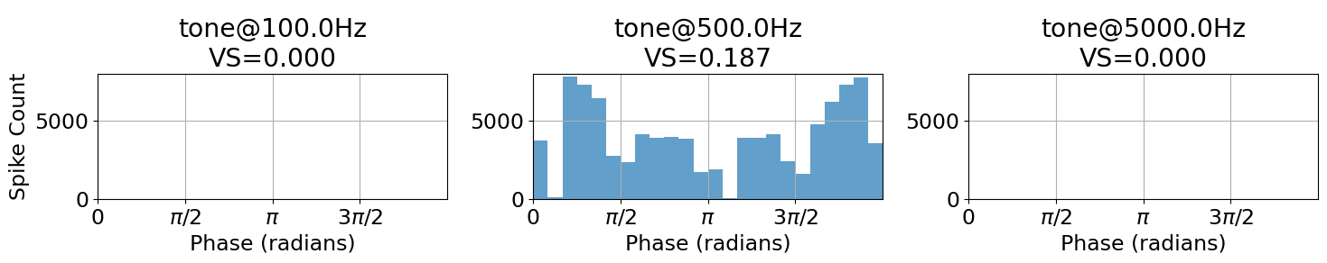
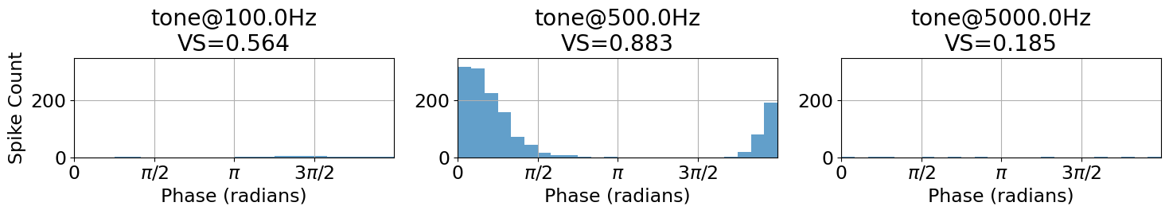
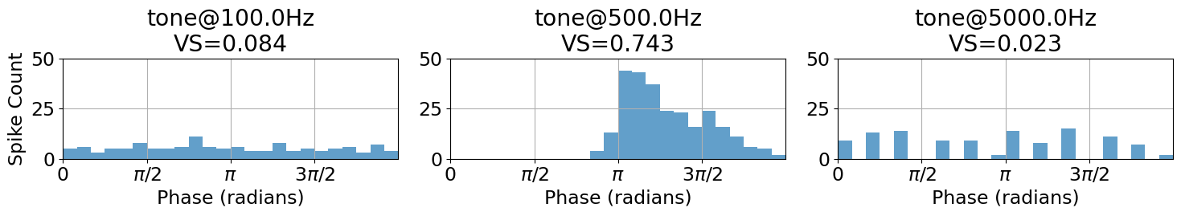
Peripheral Processing
ANF with CF=500Hz responses
PPG
Gammatone
Evaluated using vector strength:
PPG low phase locking
Gammatone fast falloff
Tan-Carney
ANF CF = input freq
Notes:
Gammatone si sincronizza anche a freq diverse

Slide 31
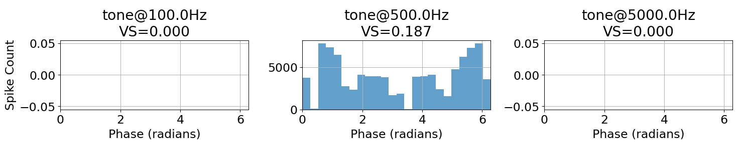
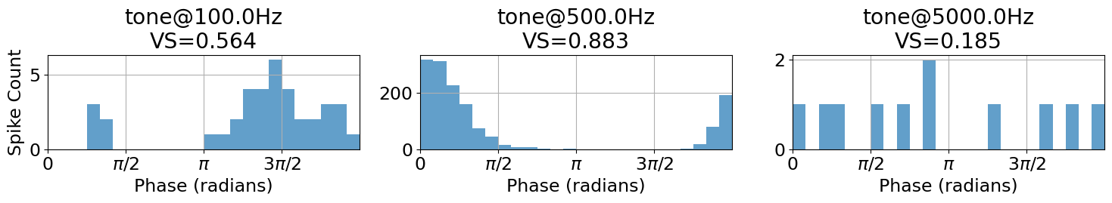
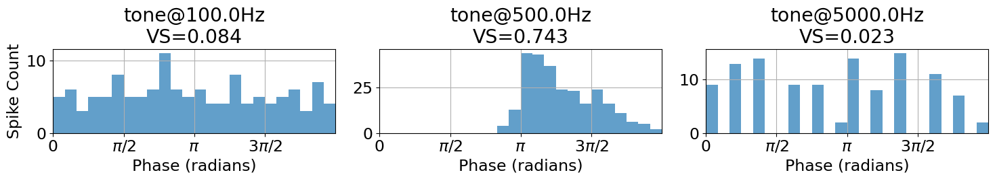
Peripheral Processing
ANF with CF=500Hz responses
PPG
Gammatone
Evaluated using vector strength:
PPG low phase locking
Gammatone fast falloff
Gammatone too high VS
Tan-Carney
ANF CF = input freq
Notes:
Gammatone si sincronizza anche a freq diverse

Slide 32
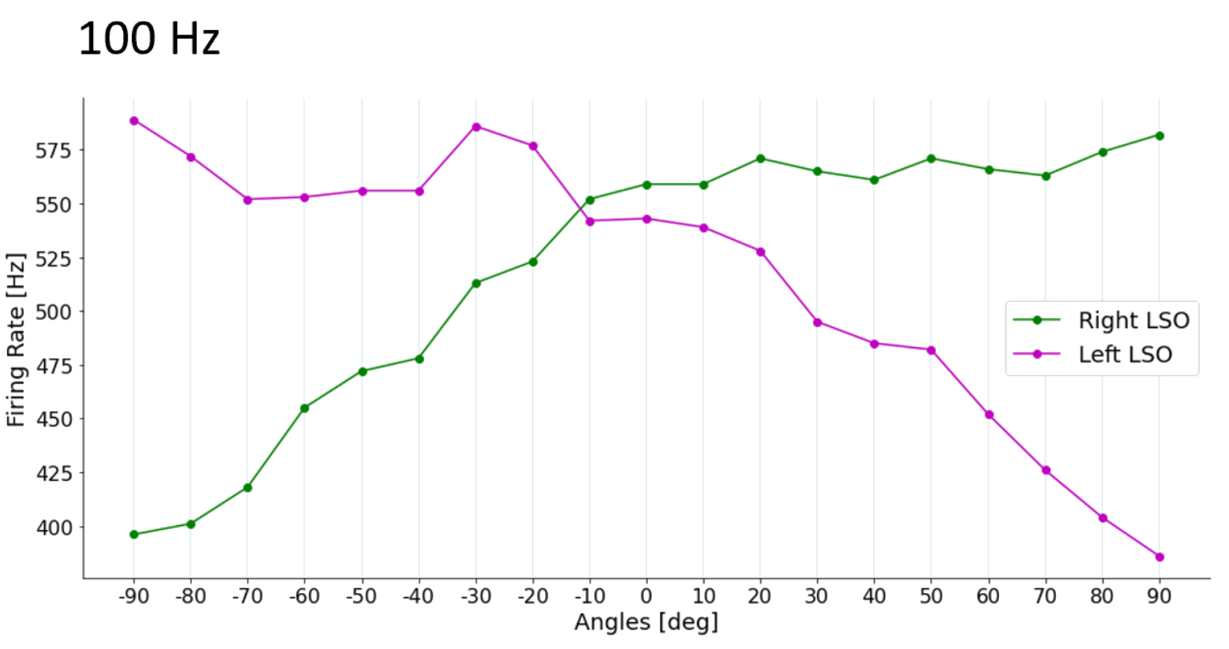
Higher centers: LSO; previous model
Notes:
This was also achieved by the model we based our work on, but with an unrealistically low membrane time constant

Slide 33
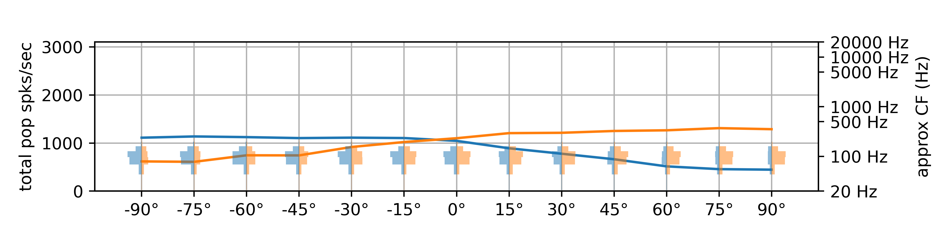
Higher centers: LSO from gammatone
100 Hz
LEFT
RIGHT
Notes:
Sigmoidal shape already present but little range

Slide 34
Higher centers: LSO from gammatone
100 Hz
1000 Hz
5000 Hz
10000 Hz
LEFT
RIGHT

Slide 35
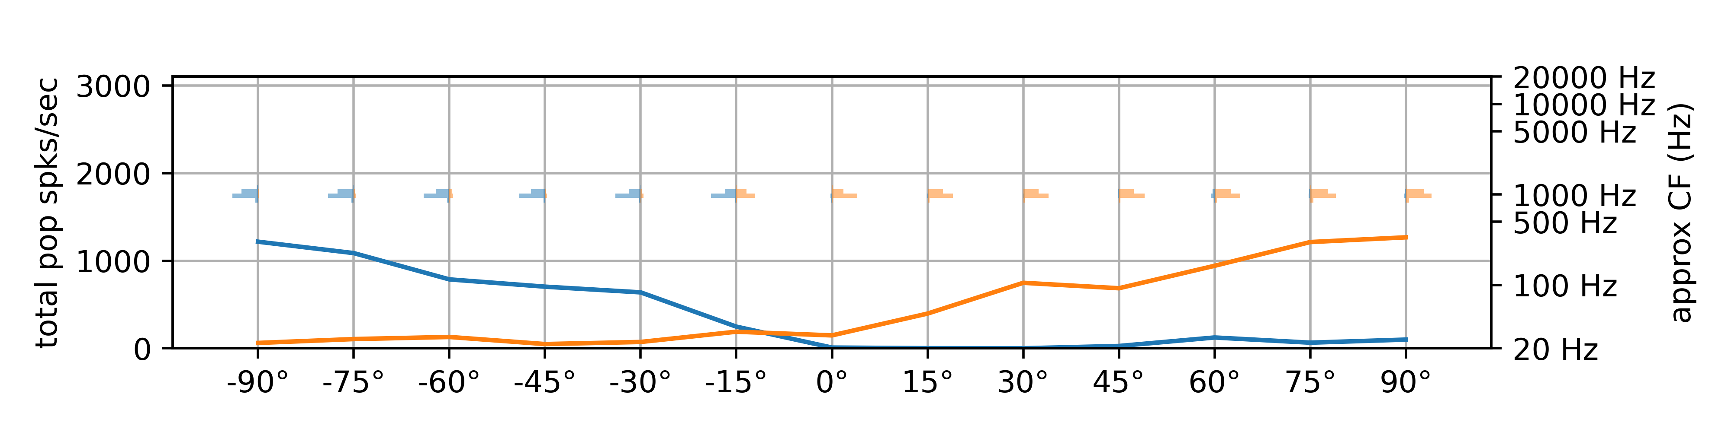
Higher centers: LSO from gammatone
1000 Hz
LEFT
RIGHT
Notes:
Increased range, still noisy sigmoid

Slide 36
Higher centers: LSO from gammatone
100 Hz
1000 Hz
5000 Hz
10000 Hz
LEFT
RIGHT

Slide 37
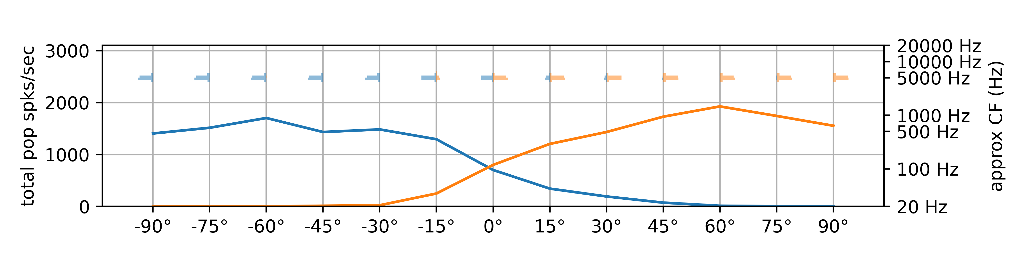
Higher centers: LSO from gammatone
5000 Hz
LEFT
RIGHT
Notes:
Best sigmoidal shape yet, strong range

Slide 38
Higher centers: LSO from gammatone
100 Hz
1000 Hz
5000 Hz
10000 Hz
LEFT
RIGHT

Slide 39
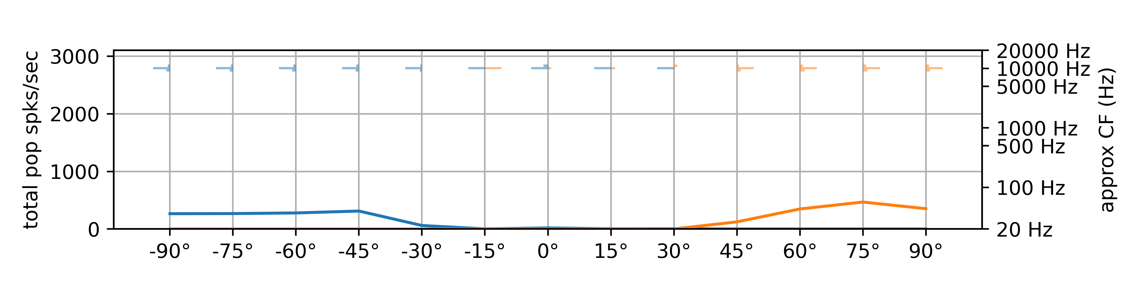
Higher centers: LSO from gammatone
10000 Hz
LEFT
RIGHT
Notes:
Degraded as inhibition begins flooding the neurons, lowering spikes

Slide 40
Higher centers: LSO from gammatone
100 Hz
Only activates a specific frequency range
1000 Hz
5000 Hz
10000 Hz
LEFT
RIGHT
Notes:
Now let’s remove the histograms…

Slide 41
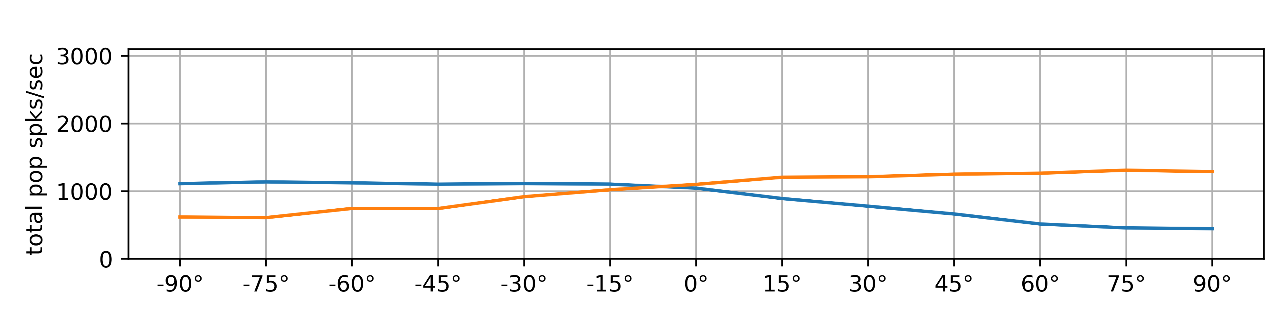



Higher centers: LSO from gammatone
100 Hz
Only activates a specific frequency range
Improves with increasing frequency
1000 Hz
5000 Hz
10000 Hz
LEFT
RIGHT
Notes:
Because what we are interested in, and what we will evaluate, is the difference between right and left, let’s scale each plot independently.

Slide 42




Higher centers: LSO from gammatone
100 Hz
Only activates a specific frequency range
Improves with increasing frequency
Degrades above 10 kHz
1000 Hz
5000 Hz
10000 Hz
LEFT
RIGHT
Notes:
This shows that while at 10khz the response is degraded, lateralization is still possible.

Slide 43




Higher centers: LSO from Tan Carney
100 Hz
Similar behavior wrt gammatone
Generalized population activation
1000 Hz
5000 Hz
10000 Hz
LEFT
RIGHT

Slide 44


Higher centers: MSO comparison
100 Hz
GAMMATONE
100 Hz
TAN-CARNEY
LEFT
RIGHT
Notes:
Existing model not comparable: MSO mechanism was different, and they focused on single neuron response instead of population response

Slide 45


Higher centers: MSO comparison
500 Hz
GAMMATONE
500 Hz
TAN-CARNEY
LEFT
RIGHT
Notes:
Existing model not comparable: MSO mechanism was different, and they focused on single neuron response instead of population response

Slide 46


Higher centers: MSO comparison
800 Hz
GAMMATONE
800 Hz
TAN-CARNEY
LEFT
RIGHT
Notes:
Existing model not comparable: MSO mechanism was different, and they focused on single neuron response instead of population response

Slide 47


Higher centers: MSO comparison
1000 Hz
GAMMATONE
1000 Hz
TAN-CARNEY
LEFT
RIGHT
Notes:
Existing model not comparable: MSO mechanism was different, and they focused on single neuron response instead of population response

Slide 48
Higher centers: MSO from Tan Carney
Generalized pop activation
100 Hz
500 Hz
800 Hz
1000 Hz
LEFT
RIGHT
Notes:
Beyond the generalized population activation, if we remove

Slide 49




Higher centers: MSO from Tan Carney
Generalized pop activation
Degrades with higher frequency (expected)
Contralateral favoring
Tan-Carney based remains active at higher freqs
100 Hz
500 Hz
800 Hz
1000 Hz
LEFT
RIGHT
Notes:
As frequency grows the quality of the MSO response degrades, which is expected to a certain extent; we would expect the MSO to work also at 1kHz, but Myoga only shows up to 800Hz as well

Slide 50

Cue integration: LSO vs IC
Notes:
Tan Carney only

Slide 51

Cue integration: LSO vs IC
Notes:
Remember that contralateral LSO connects to IC

Slide 52
Results: LSO-only vs IC (LSO+MSO)
ZERO-CROSSING ACCURACY
STEEPNESS
RANGE
+18.1%
-15.5%
+19.1%
(2°)

Slide 53
Discussion
04

Slide 54
Conclusions and future work
Increase bioplausibility
Alternative ITD coding in MSO
Cue integration in IC
Bioplausible peripheral processing sections include fundamental properties
The results show promise, and echo biological results
The MSO does not seem to provide valuable information for a simple EE scheme
SO FAR
Try other HRTF datasets
More investigation needed at the single neuron level
More complex cue integration schemes may be needed
Additional research may focus on MSO as dynamic, sound segregating machine
FUTURE
Grothe, B., Pecka, M., 2014. The natural history of sound localization in mammals - a story of neuronal inhibition. Front. Neural Circuits. 8. https://doi.org/10.3389/fncir.2014.00116
Notes:
Mention maybe MSO for dynamic difference

Slide 55
Thank you for your attention
Paolo Marzolo

Slide 56
Questions that I could think of
CHILL
TOUGH
Wouldn't steepness be maximized by a step function (unable to localize)?
<your own>
Why are you comparing LSO response to ILD (bio experiments) to LSO response to hrtf (silico)?
Why are you comparing single neuron response MSO (bio) to population response (silico)?

Slide 57

MSO single vs population

